Slide 1
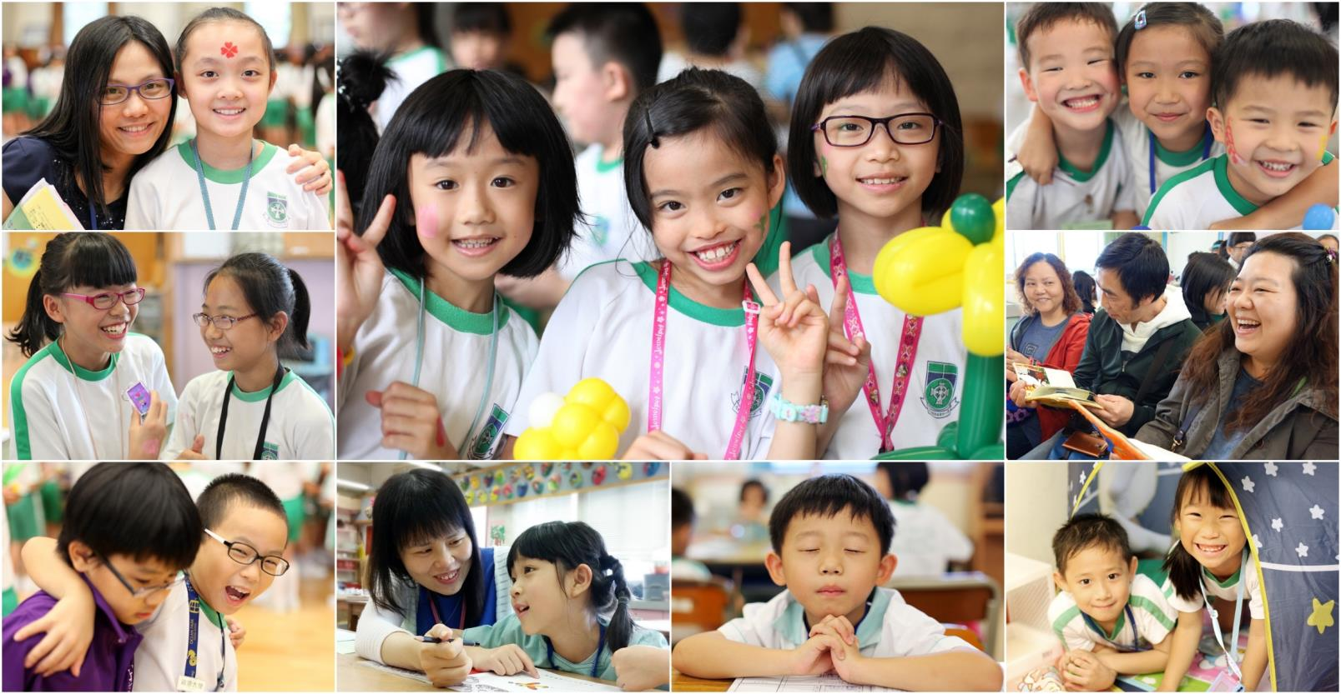
Tin Shui Wai Methodist Primary School
Tel: 24480373 Principal: Mr. So Ping Fai
Fax: 24480877 Address: Area 31, Phase 1, Tin Shui Wai, N.T.

Slide 2
Through-train school system
One of the primary schools founded by the Methodist Church, H.K.
6 years of primary education at our school
6 years of secondary education at Tin Shui Wai Methodist College
Notes:
信念

Slide 3
School Timetable
Time | Monday | Tuesday | Wednesday | Thursday | Friday
8:00-8:20 | Morning reading
8:20-8:34 | Collecting HW
8:34-9:08 | 1
9:08-9:42 | 2
9:42-10:16 | 3
10:16-10:46 | Recess
10:46-11:20 | 4
11:20-11:54 | 5
11:54-12:28 | 6
12:28-12:58 | Lunch
12:58-1:18 | Recess
1:18-1:52 | 7
1:52-2:26 | 8
2:26-3:00 | 9
3:00-3:15 | Clean-up
3:15-4:30 | ECA
Core subjects
Co-operative learning, cater individual differences and learning styles
Visual arts/ PE/ Music/ Robotics and Technology/ Life Education/ Bible Studies/ Homework lesson
Class teacher period/ Tuition class/ ECAs

Slide 4
Preparing students for the future
2nd home
Enriching students’ life experiences
Love
Building up a campus with love and care
Establishing good learning habits and methods
Notes:
信念

Slide 5
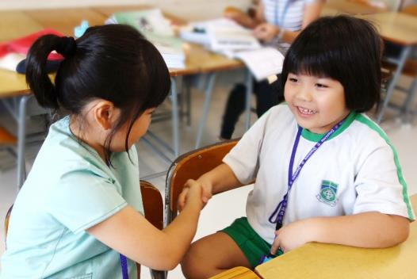
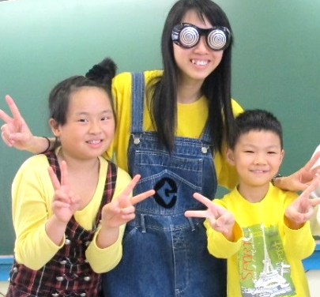
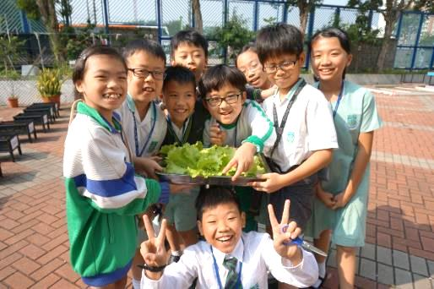
Building up a campus with love and care
2nd home
Love
Class building
Life education
Average placement, mixed ability groupings
Same teacher-students combination for 3 years → better relationship
Build up T-S and S-S rapport: －bridging course/ inter-class competitions/ class-based activities/ class committee/ class teacher lesson in first 2 weeks

Slide 6
Enriching students’ life experiences
Cross-disciplinary curriculum
Each form has its own themes and all the subjects are involved to make the learning experiences more comprehensive
Language learning environment
7 NETs help enriching the English learning atmosphere and establishing a culturally rich environment
Chinese subject is taught in Putonghua
Different famous classical stories
STEM, robotic and technology
Learning basic coding
Doing science experiments

Slide 7
Enriching students’ life experiences
Linking to the curriculum

Slide 8
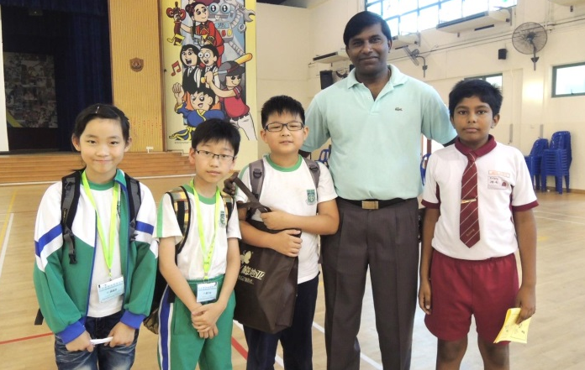
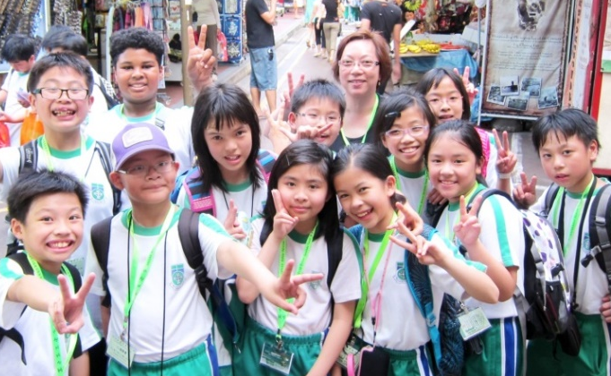
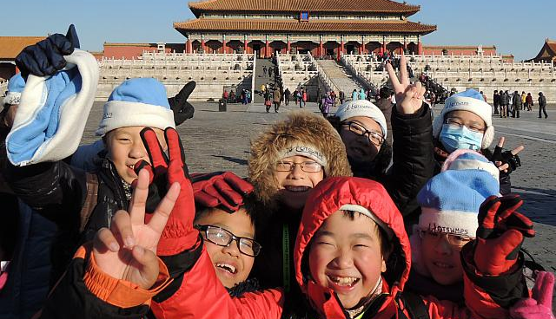
Enriching students’ life experiences
營造關愛校園
P5 Trip to Singapore
P4 Trip to Macau
P6 Trip to Beijing
Oversea trips with different themes
P4 Macau: Preserving cultures and old buildings P5 Singapore: Respecting different cultures and races P6 Beijing: Knowing our motherland

Slide 9
Enriching students’ life experiences
營造關愛校園
P5 Trip to Singapore
P4 Trip to Macau
P6 Trip to Beijing
Learning targets:
Learning how to take care of oneself
Experiencing different cultures and traditions
Cooperating and collaborating with others
Solving problems

Slide 10
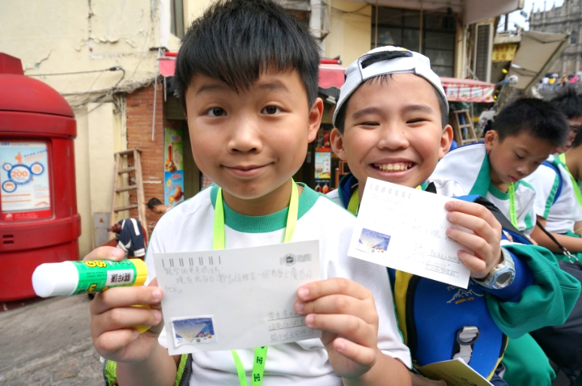
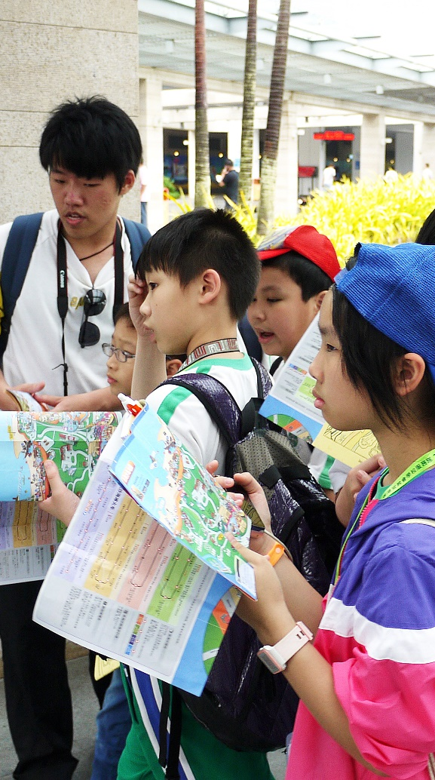
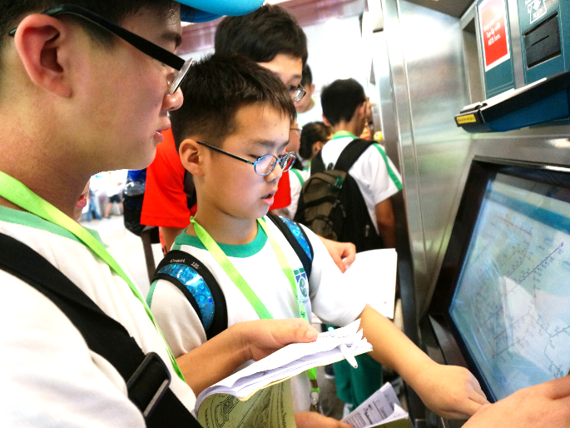
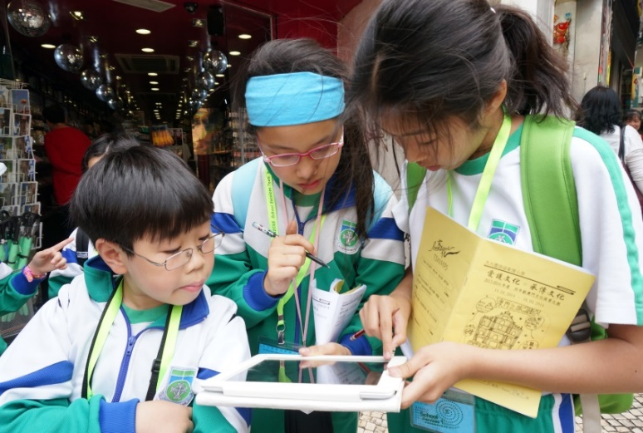
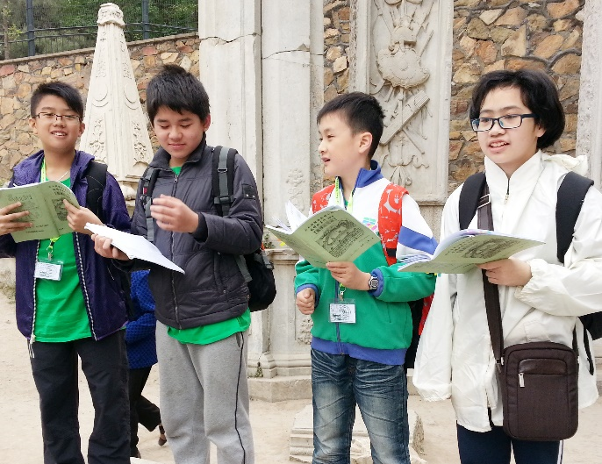
Enriching students’ life experiences
Orienteering – self-directed way to discover and explore different places and cultures

Slide 11
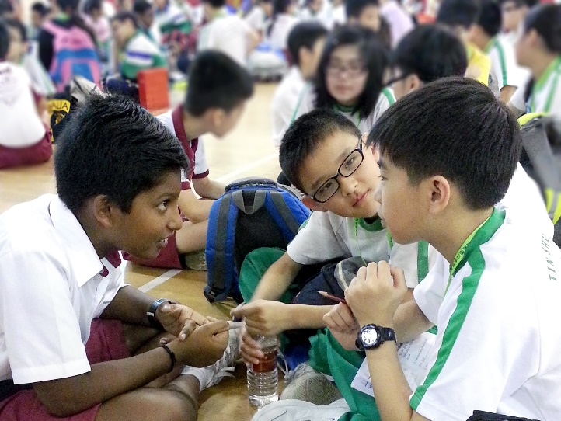
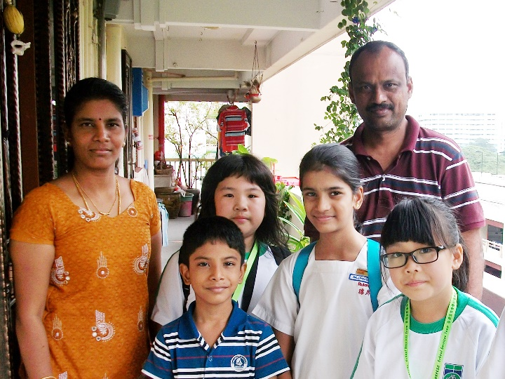
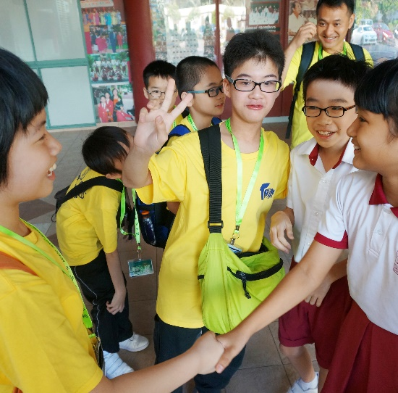
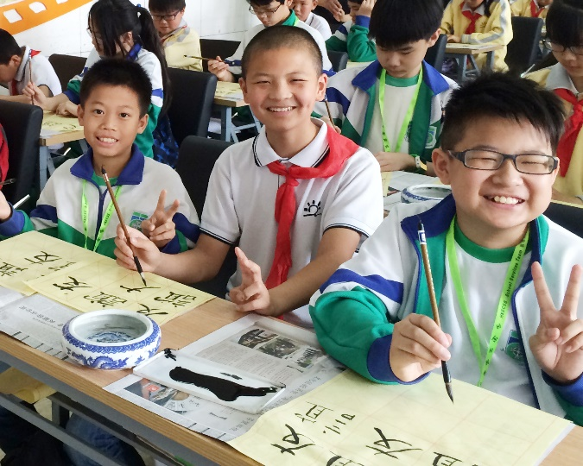
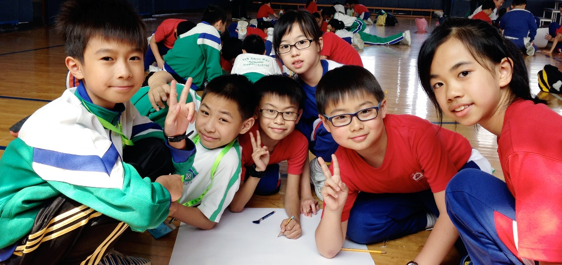
Enriching students’ life experiences
Visiting local schools and learn from one another
Macau：澳門培正中學（小學部）
Singapore：Rulang Primary School 北 Beijing：芭樂園學校、宏廟小學、忠德學校

Slide 12
ＳＴＥＭ
General Studies School-based
MI curriculum

Slide 13
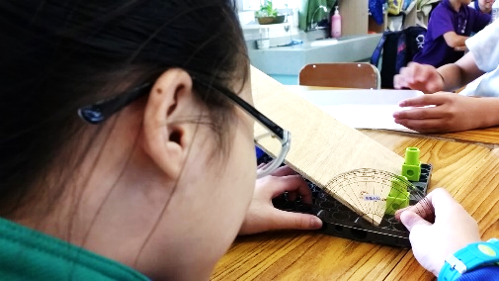
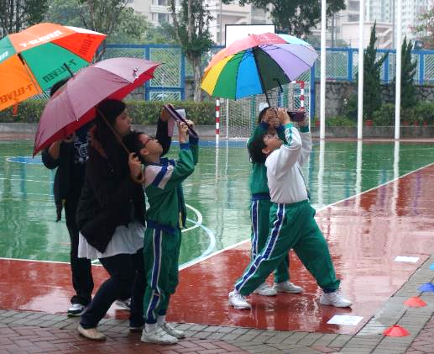
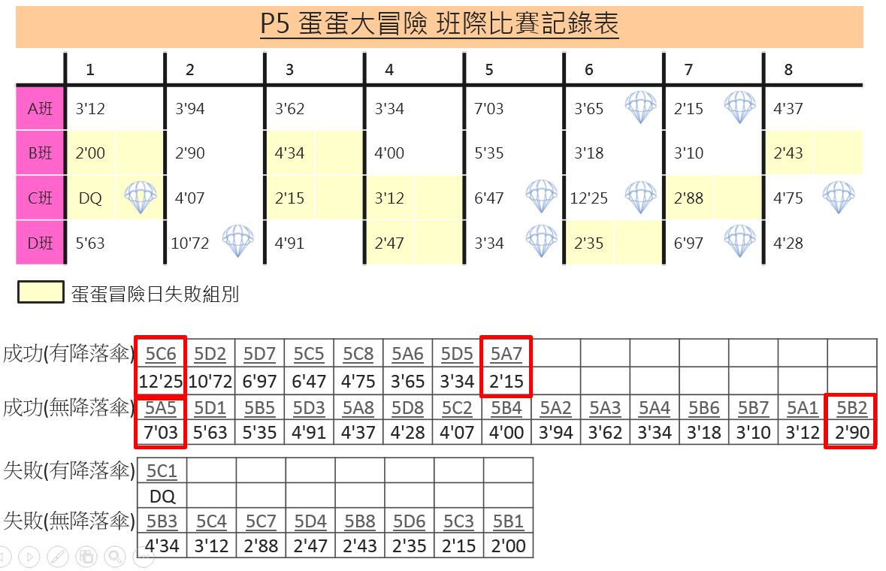
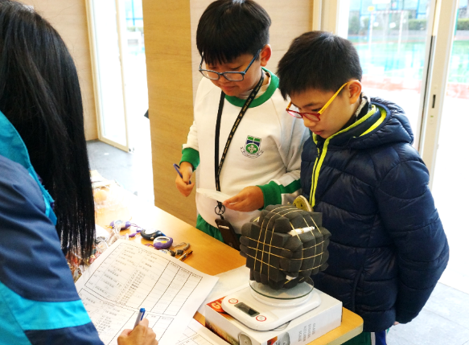
ＳＴＥＭ
General studies School-based
MI curriculum
ＳＴＥＭ
Learn to observe, to analyze,
to apply and to create

Slide 14
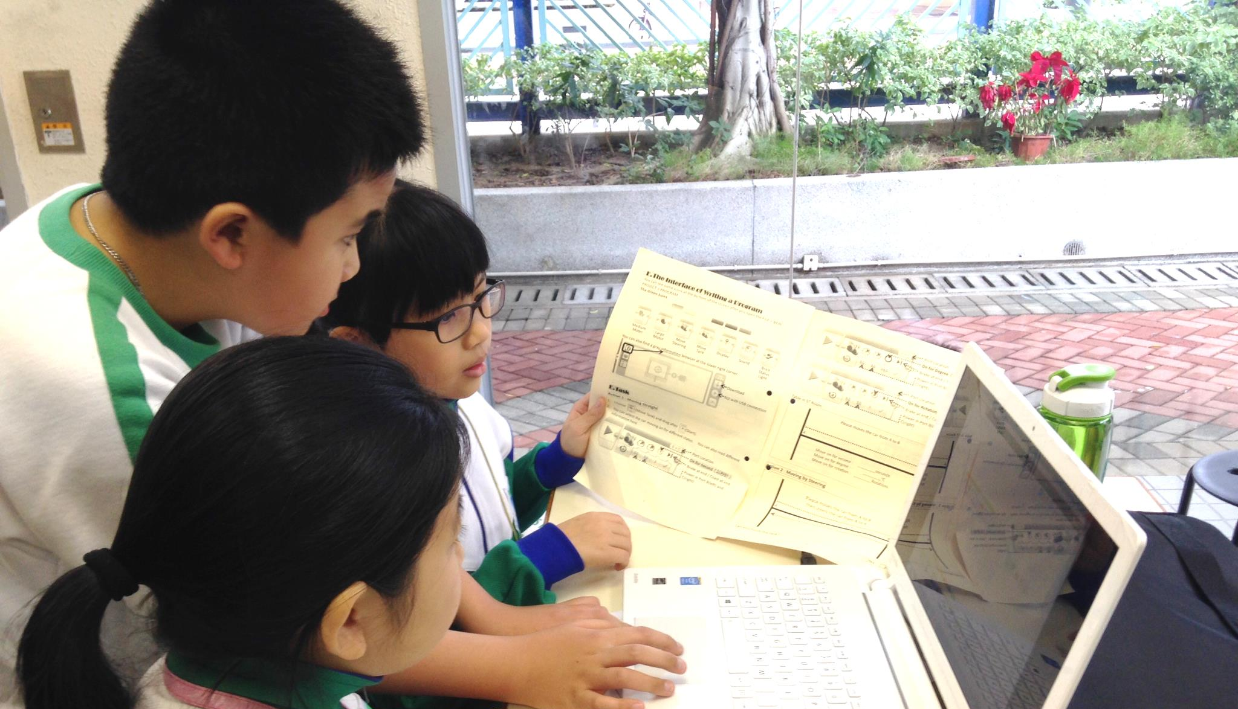
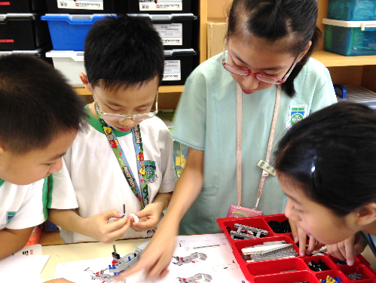
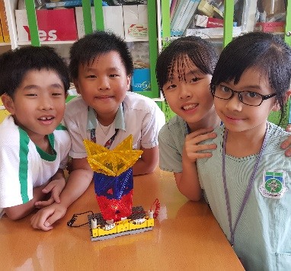
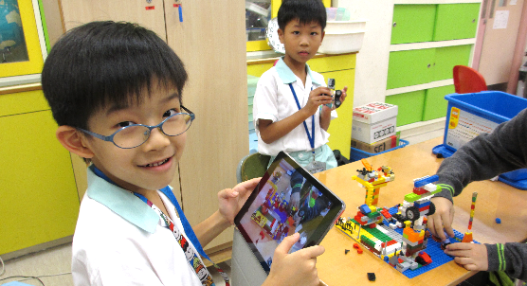
ＳＴＥＭ
General Studies School-based
MI curriculum
ＳＴＥＭ
 | Theme
P1 | Dream City
P2 | Little transporter
P3 | Little engineer
P4 | Learning by playing
P5 | Ideal TSW
P6 | Upcycling
Science
experiments
Robot
building
Fun & R Tech
Coding
IT skills

Slide 15
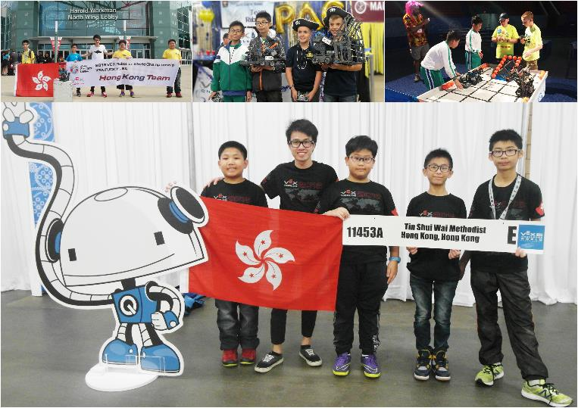
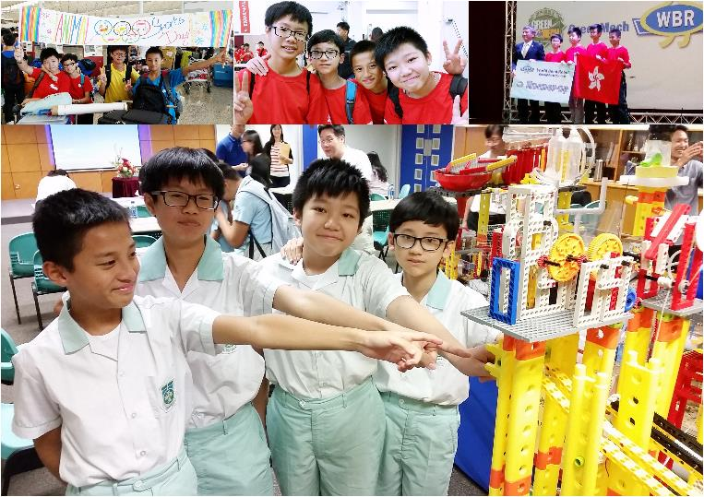
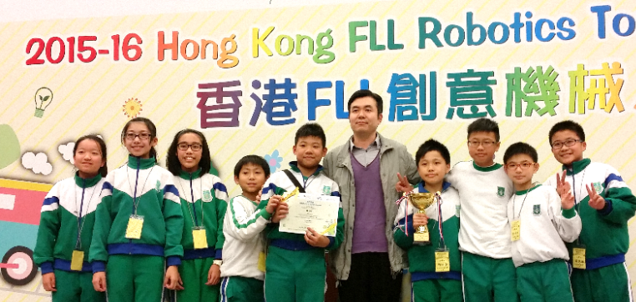
Preparing students’ for the future
Developing students’ potentials
香港FLL創意機械人大賽：一等獎、項目研究獎冠軍
VEX IQ Robot Competition：香港區冠軍、世界賽（美國）香港代表隊
機關王大賽：香港區季軍及最佳合作奬、世界賽（台中）亞軍
智能機械由我創：一等獎

Slide 16
For enquiry:
Please contact Miss Javis Li at 24480373 or email@campus.tswmps.edu.hk
Notes:
信念

